Slide 1
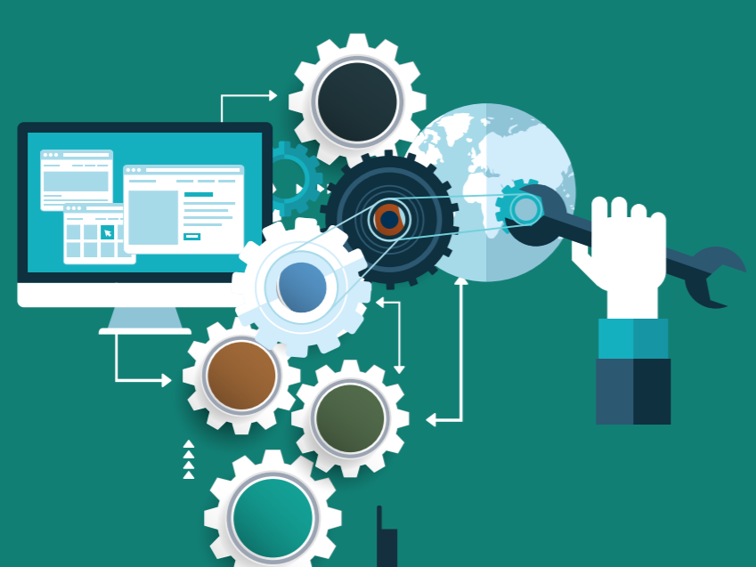

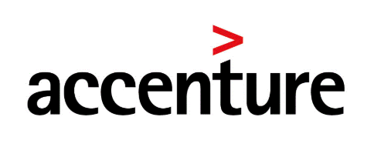
AGENDA: DEVOPS CULTURE / METHODOLOGY
What is DevOps?
Why do I need DevOps?
What is needed for DevOps to work?
Where is DevOps applicable? | CALMS Model
DevOps Lifecycle & Release Management Process
DevOps Practice’s
DevOps with Agile | SDLC
DevOps | Containerization
DevOps Roadmap
DevOps Tools & Roles
DevOps | IAC & Serverless CICD | Practical Hands-On

Slide 2
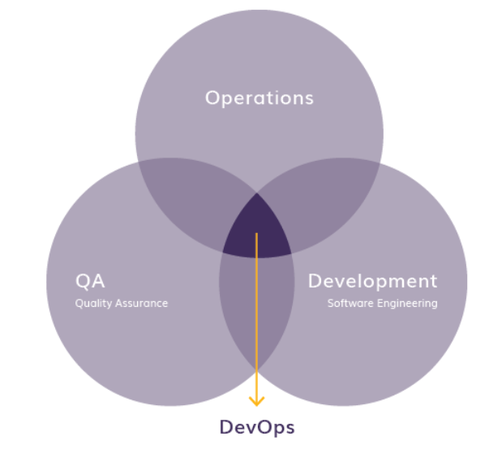
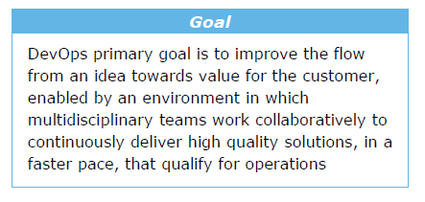
DevOps Methodology
What is DevOps?
It’s a culture of trust and collaboration in which professionals use the right tools to achieve continuous delivery of business value.
DevOps combines software development (Dev), Quality Assurance (QA) with information technology operations (Ops) participating together in the entire service lifecycle, from design through the development process to production support.
DevOps leverages collaboration, tool-chain integrations, automation, Cloud adoption, improved processes and more standardizations, to building trust and improve productivity across development, QA and IT operations teams.
DevOps is a movement that improves IT service delivery agility, ensures software quality, security, availability, reliability & performance.

Slide 3
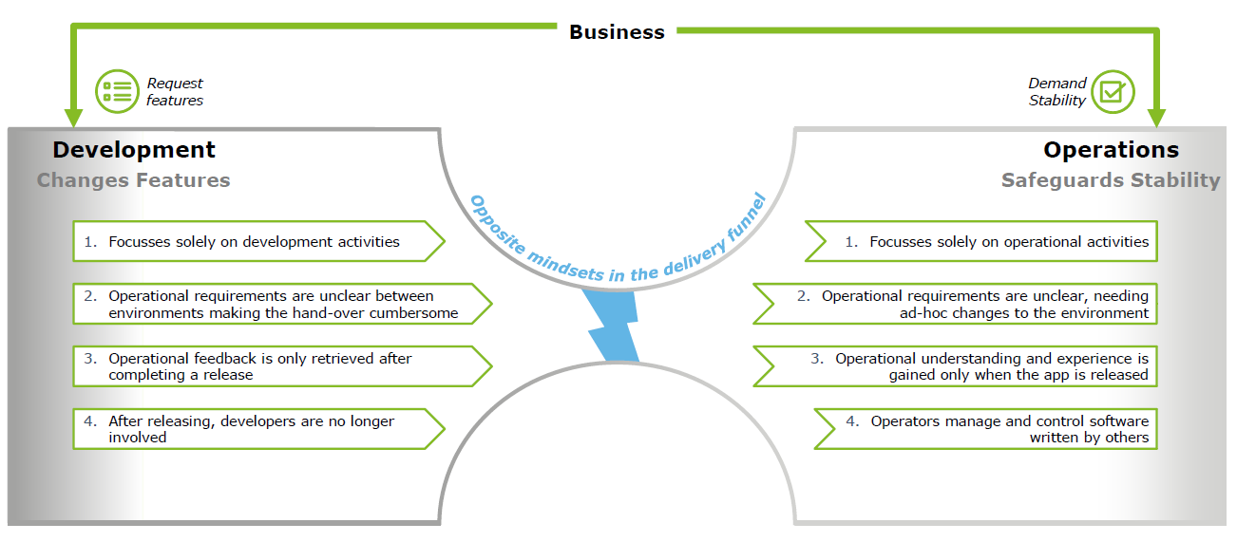
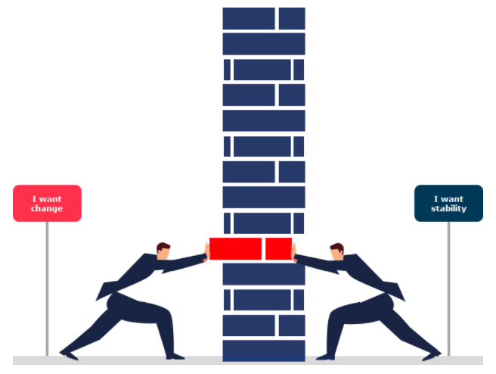
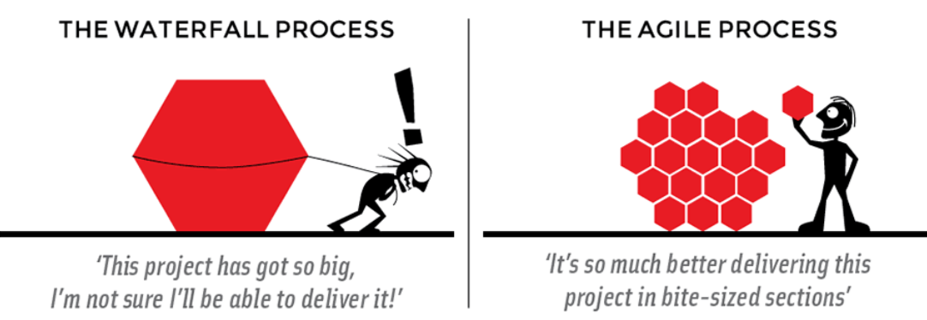
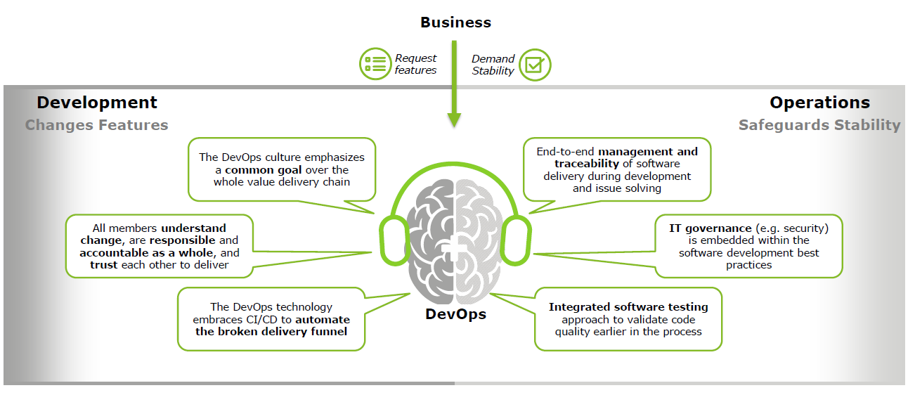
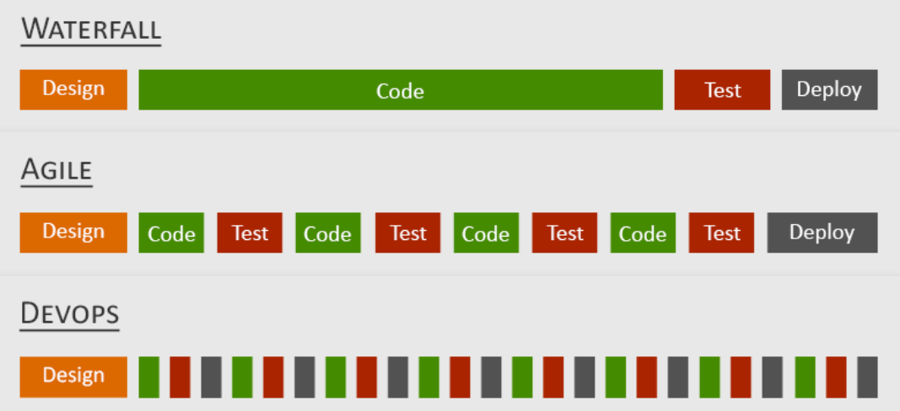
Why do I need DevOps?
Prior to DevOps change release frequency was all manual efforts with low & slow process, Development and Operations worked separately to serve business demands, having completely opposite mindsets & largely used to apply waterfall SDLC Concepts rather than Agile process.
Today business wants to release on demand. With DevOps, both functions continuously collaborate to align business demands within the software delivery lifecycle.

Slide 4
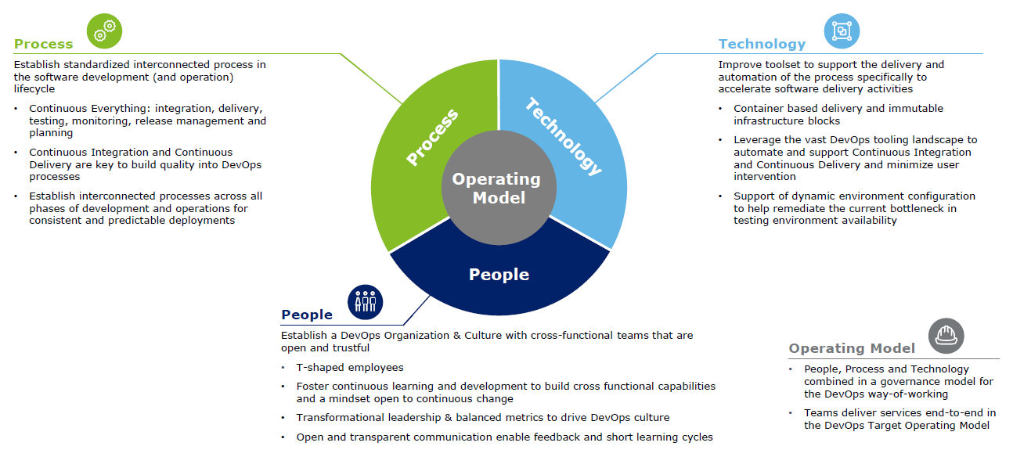
What is needed for DevOps to work?
The DevOps operating model is structured along People, Process and Technology, each dimension is necessary for successful DevOps

Slide 5
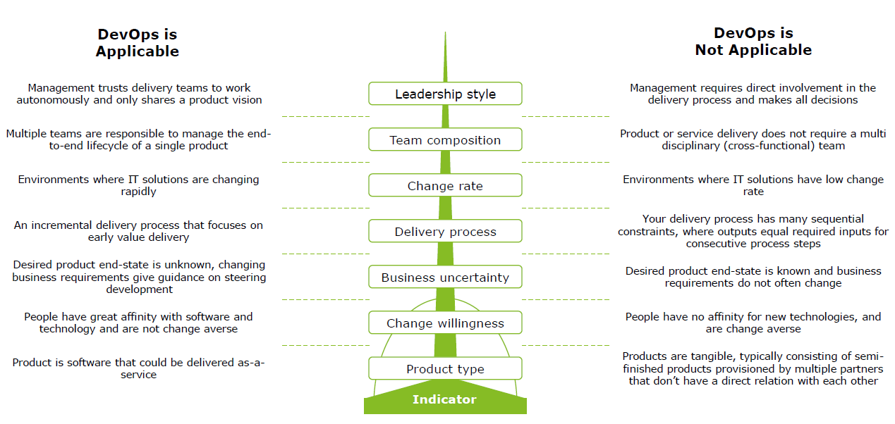
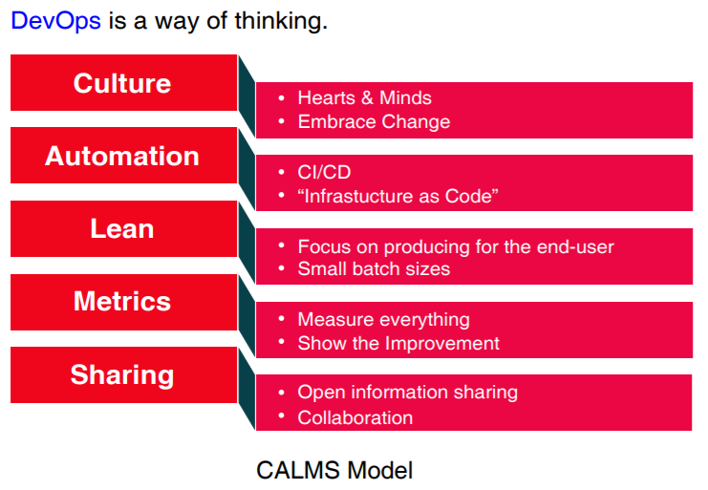
CALMS Model
Where is DevOps applicable?
Several indicators help to determine if DevOps is applicable for your organization

Slide 6
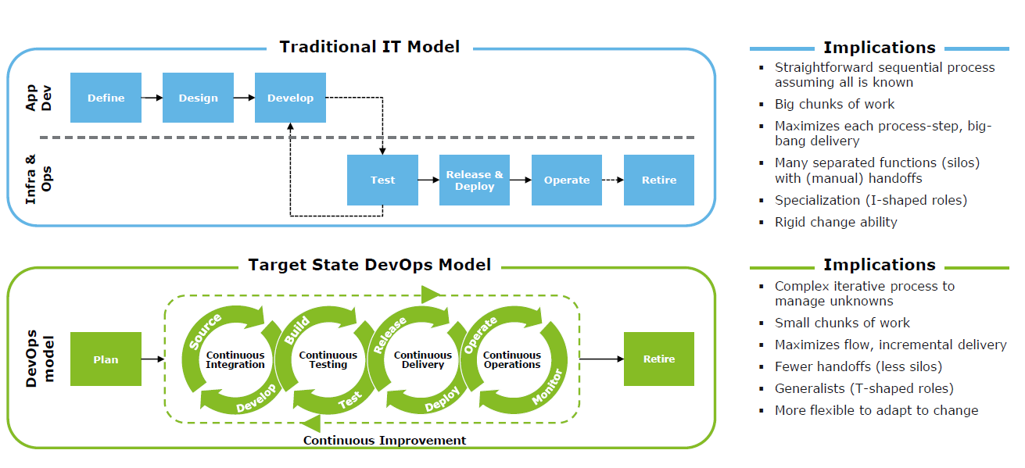
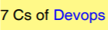
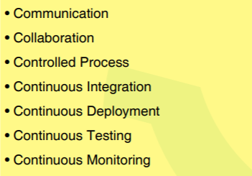
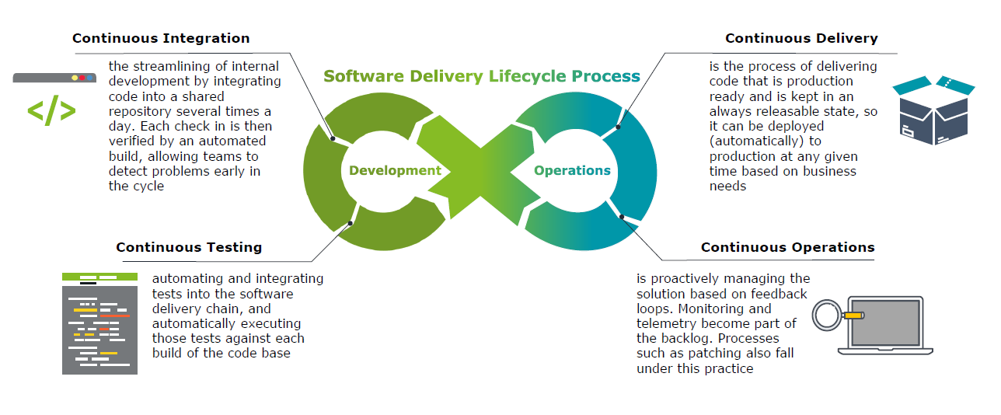
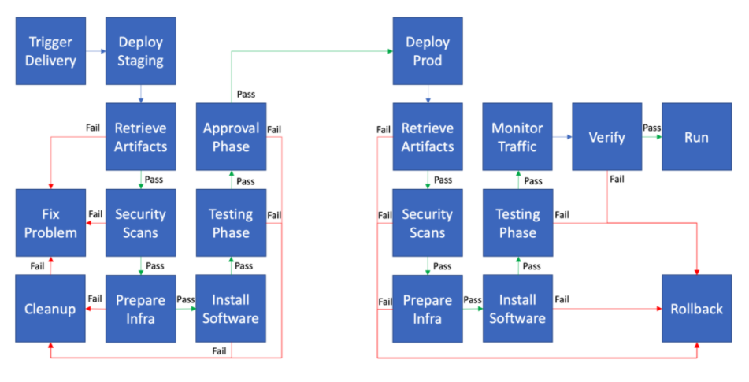
DevOps Lifecycle & Release Management Process
The DevOps model is significantly different from the traditional IT model.
DevOps integrates the application lifecycle into an end-to-end, iterative process.

Slide 7
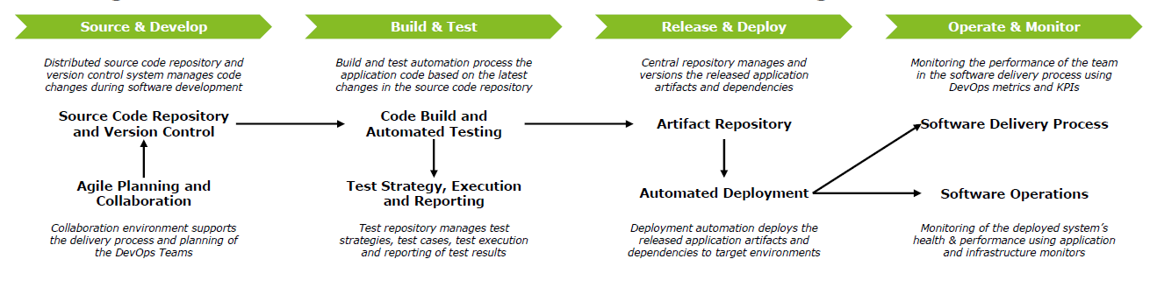
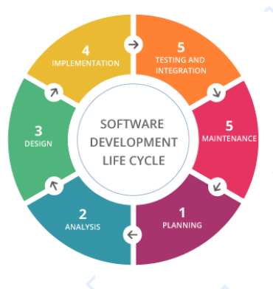
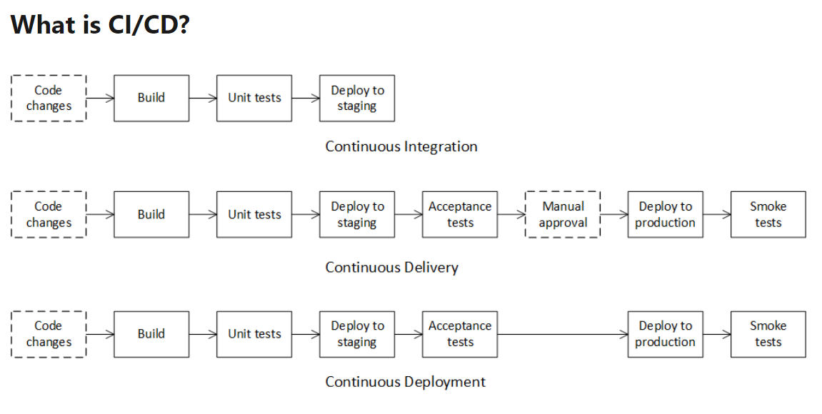
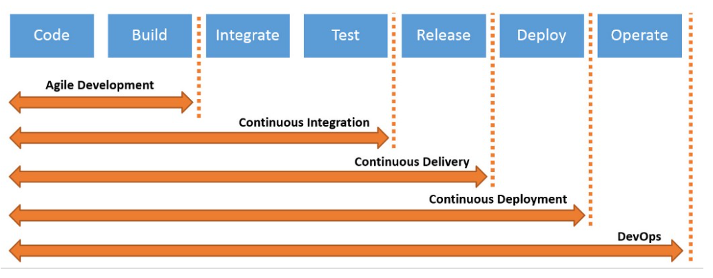
DevOps Lifecycle & Release Management Process
DevOps dimensions
DevOps Process | CI/CD Flow
A CI/CD Pipeline can be built in various ways considering the desired tooling patterns, covering the same functional flow with different tools and integrations between them.

Slide 8
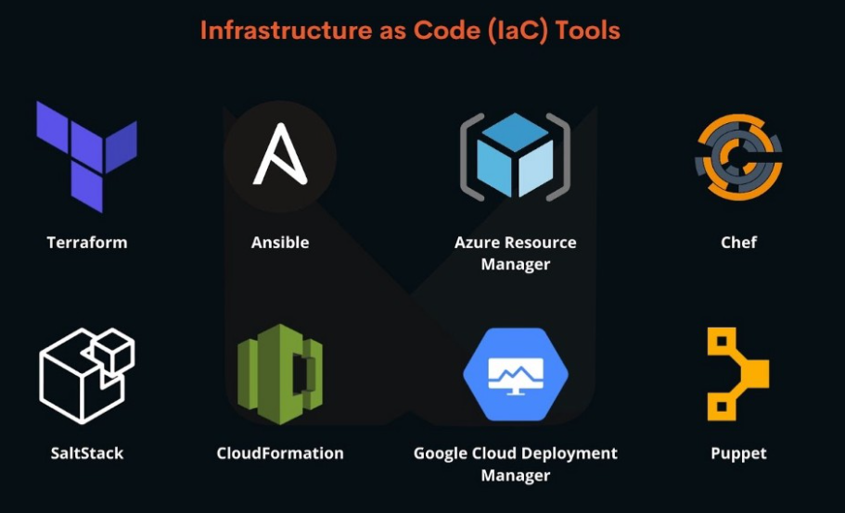
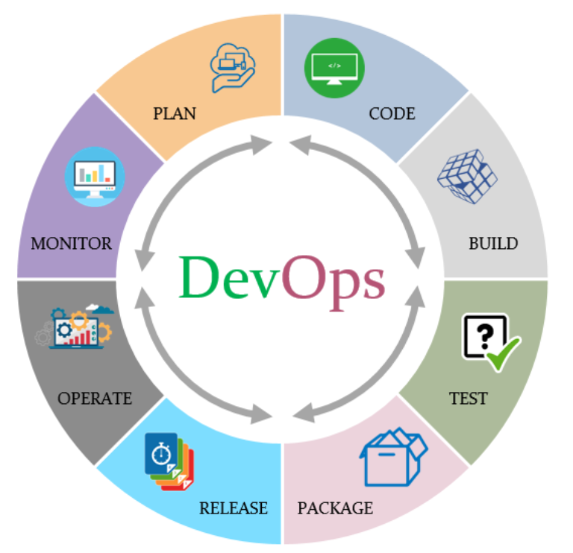
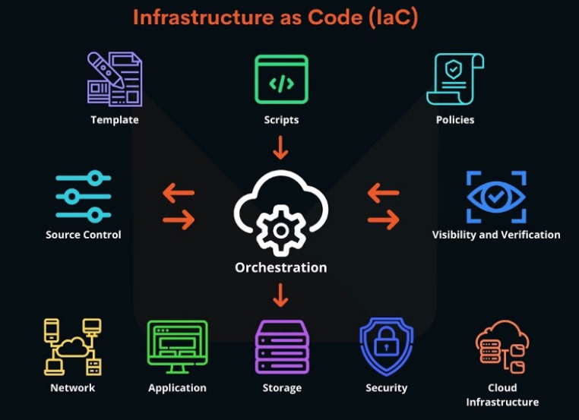
DevOps Practice’s
Continuous Integration/Continuous Delivery. CI/CD pipelines are the lifeblood of the DevOps philosophy. Continuous integration means building and regularly validating the project by updating code changes at set intervals. Continuous delivery builds off CI by automatically deploying code in the production environment.
Microservices. Build and deploy a microservices architecture using container or serverless computing.
Infrastructure as Code. This practice provisions and manages your cloud resources by writing a template file that is machine consumable and human-readable.
Monitoring and Logging. All system activity needs to be monitored and recorded to assure that events get triggered at the right time, and also to correct anything that isn't performing well.
Communication and Collaboration. Every team and department needs to be on board with the project and stay informed. Additionally, there needs to be a forum to share useful feedback that may shape the course of the project.

Slide 9
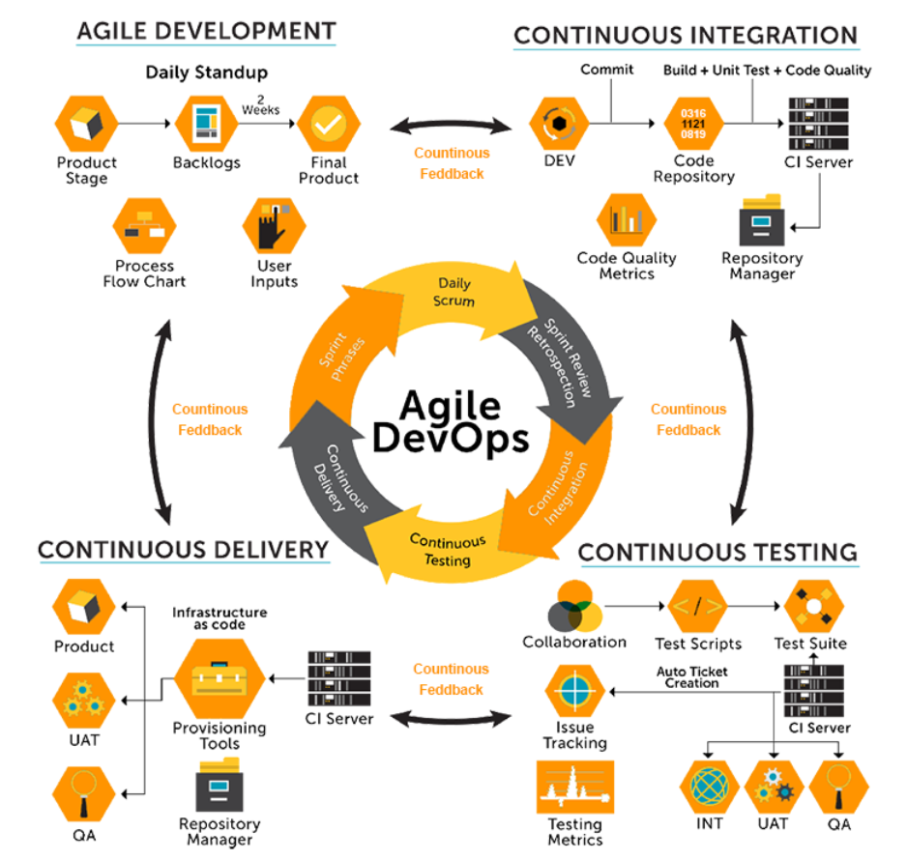
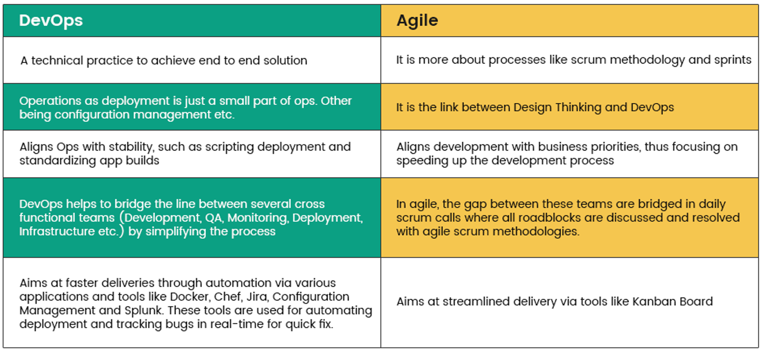
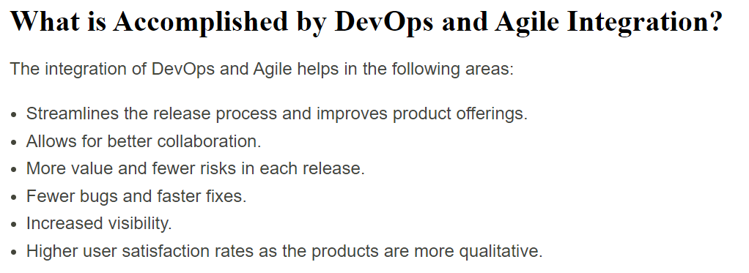
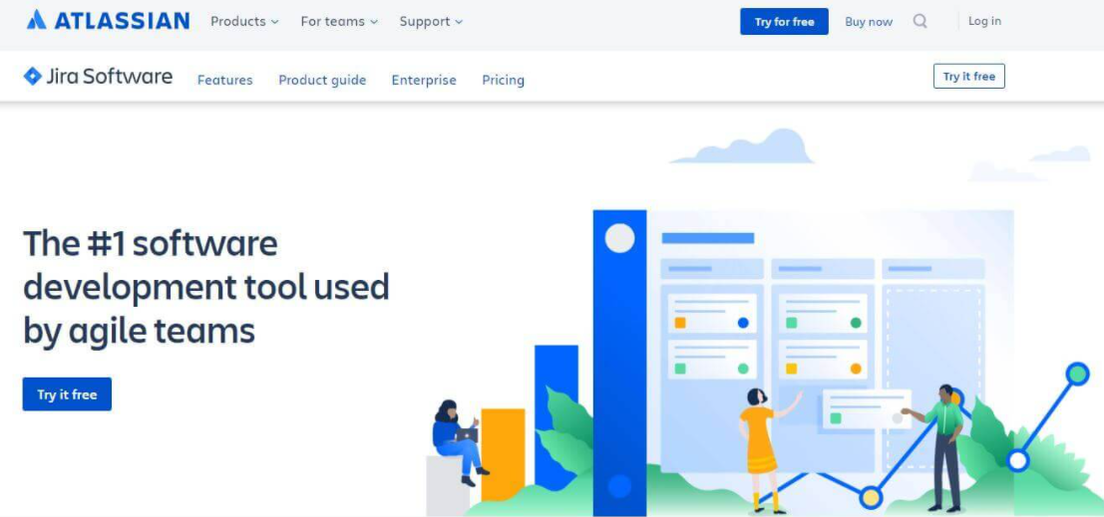
DevOps with Agile | SDLC

Slide 10
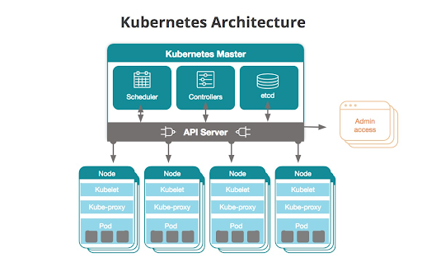
DevOps | Containerization
What is Kubernetes?
Containers are a good way to bundle and run your applications. In a production environment, you need to manage the containers that run the applications and ensure that there is no downtime. For example, if a container goes down, another container needs to start. Wouldn't it be easier if this behavior was handled by a system?
That's how Kubernetes comes to the rescue! Kubernetes provides you with a framework to run distributed systems resiliently. It takes care of scaling and failover for your application, provides deployment patterns, and more. For example, Kubernetes can easily manage a canary deployment for your system.
Kubernetes is a portable, extensible, open-source platform for managing containerized workloads and services, that facilitates both declarative configuration and automation. It has a large, rapidly growing ecosystem. Kubernetes services, support, and tools are widely available.

Slide 11
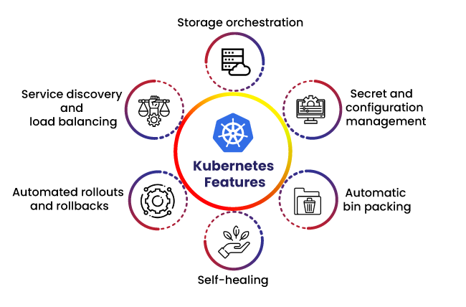
Benefits of Kubernetes-
Service discovery and load balancing
Storage orchestration
Automated rollouts and rollbacks
Automatic bin packing
Self-healing
Secret and configuration management

Slide 12
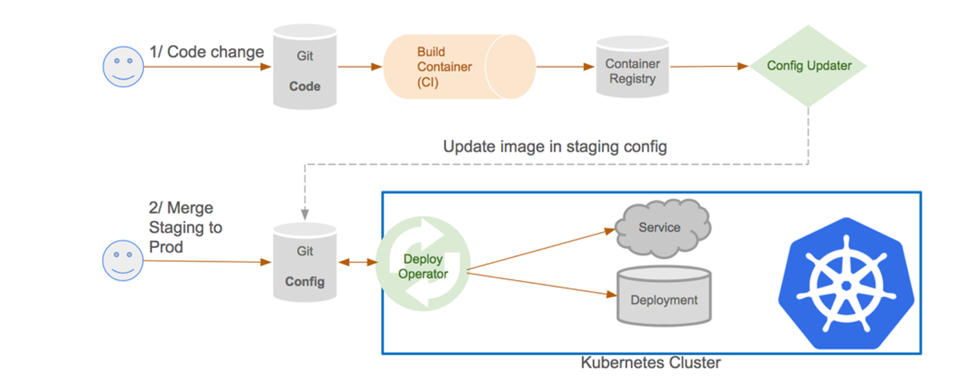
CI/CD Pipeline for Kubernetes Deployment-

Slide 13
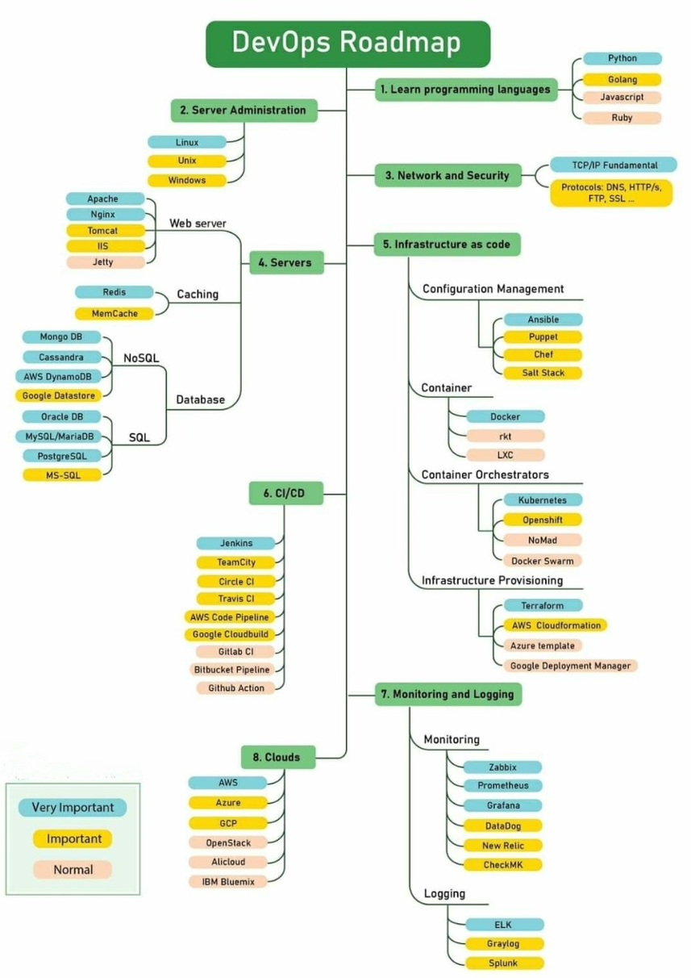
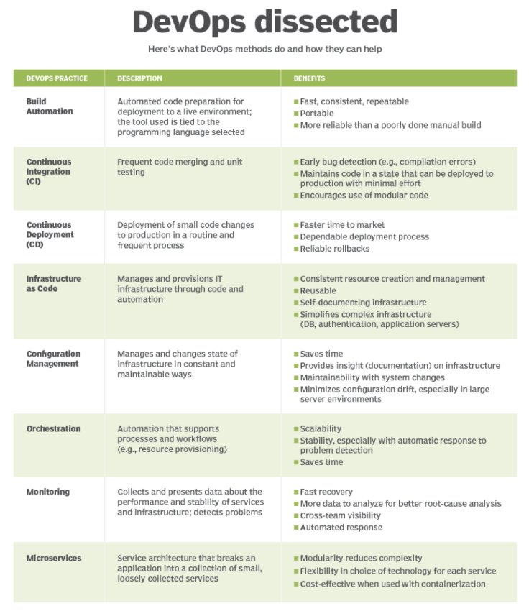
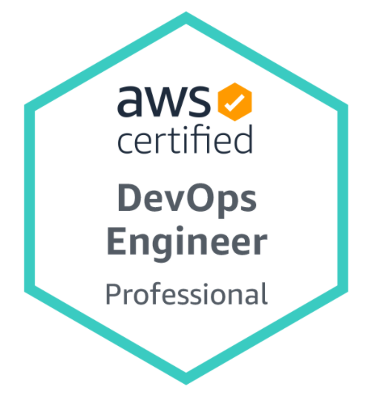
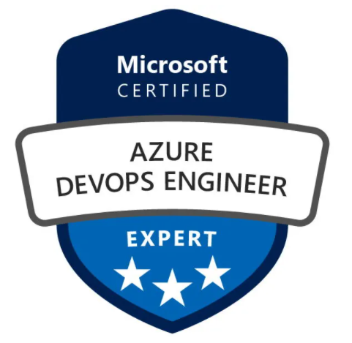
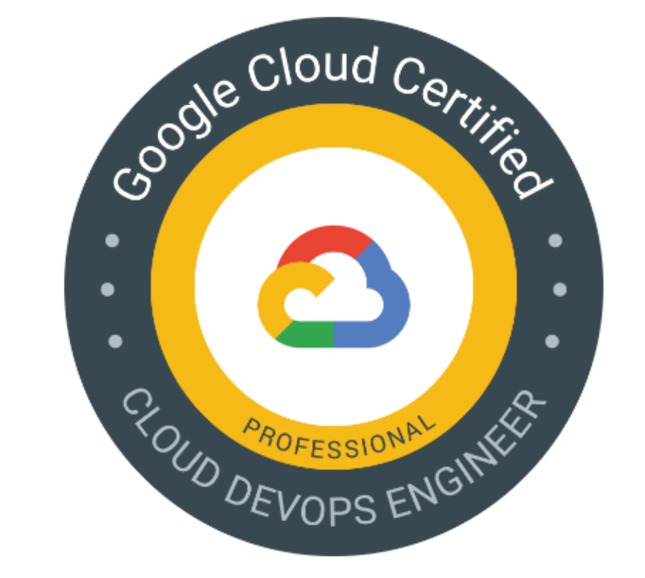

Slide 14
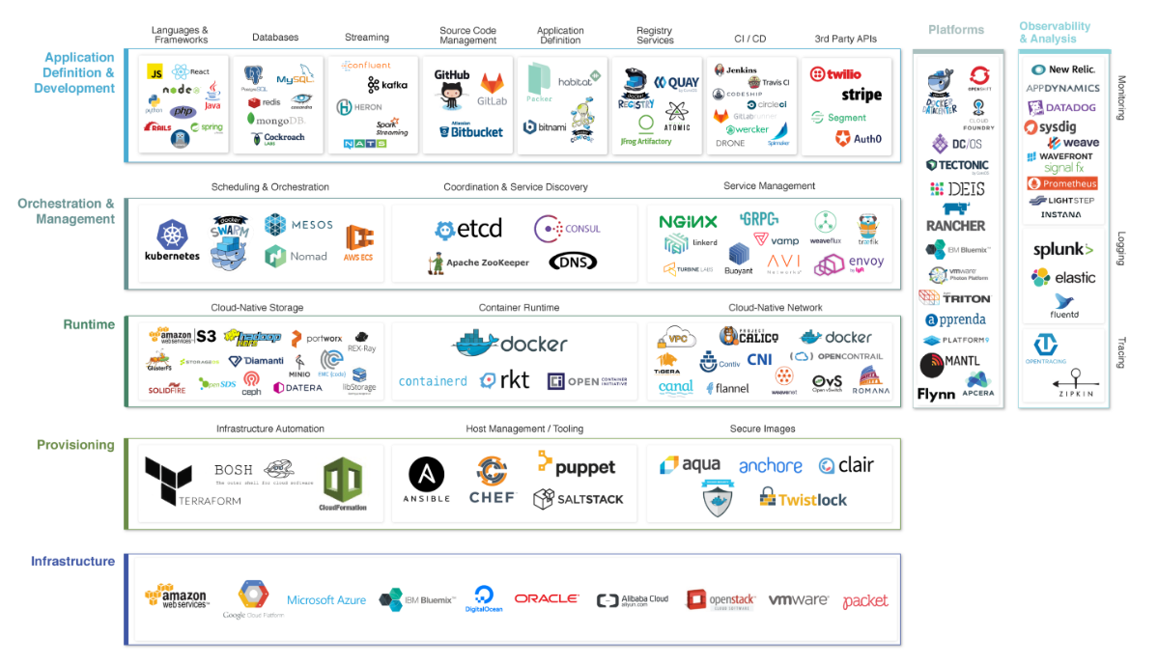
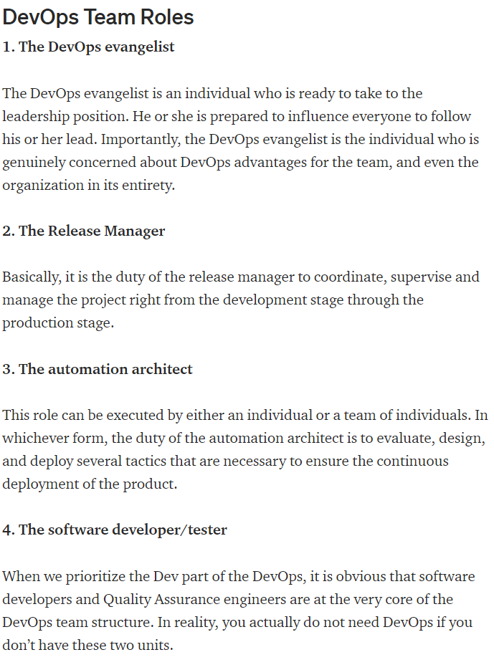
DevOps Tool’s | Landscape

Slide 15

HANDS-ON

Slide 16
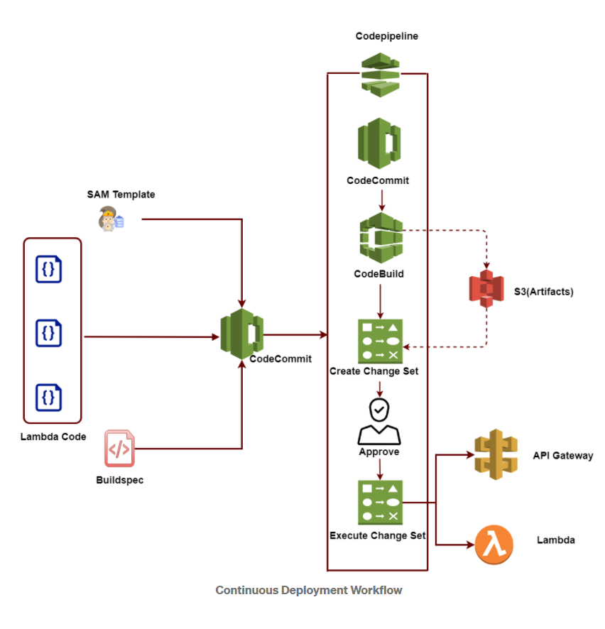
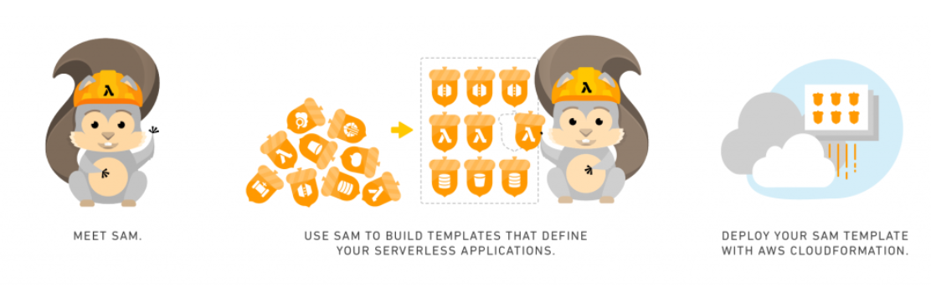
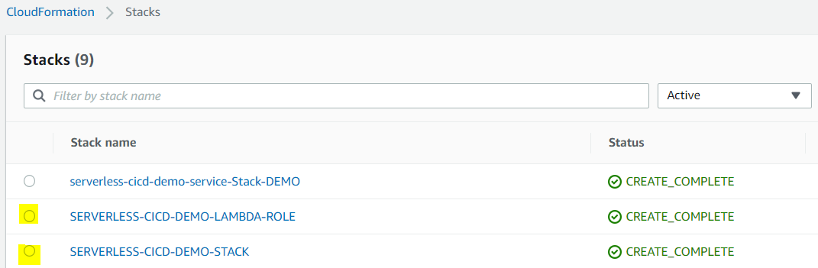
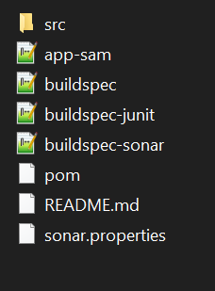
DevOps | IAC & Serverless CICD | Practical Hands-On
In this Hands-on lab we will practice one of the solutions w.r.t DevOps practice’s which included CICD Workflow for a Continuous Delivery Pipeline for a Lambda Application with AWS CodePipeline , AWS SAM & AWS Cloudformation
We will be building the Serverless Architecture which include all the components & CICD workflow in an automated way using below DevOps techniques.
We will have AWS Cloudformation Yaml formatted file’s which will help us automate the creation of all the Serverless Architecture components like CodeCommit, CodePipeline, Codebuild, S3 Buckets, Lambda IAM Role etc using AWS Cloudformation console.
Once we have the Components created automatically, we will be cloning the AWS CodeCommit repository locally, or use the Github repo & upload all the below necessary sample files .
The sample repo consists of SAM Cloudformation template which will have the required Lambda functions to deployed details.
Buildspec file will help with building of the code file & creating a zip artifacts & upload it to crated S3 Bucket.
Buildspec-juinit file can help in terms of Unit testing of code prior to deployment as part of DevSecOps capability.
Buildspec-sonar can also help in for code scanning. ( Excluded for now )
Pom is a sample file which will help for building of code as the backend is Java. For Python language the file structure could differ, but the concepts will remain more or less same.

Slide 17
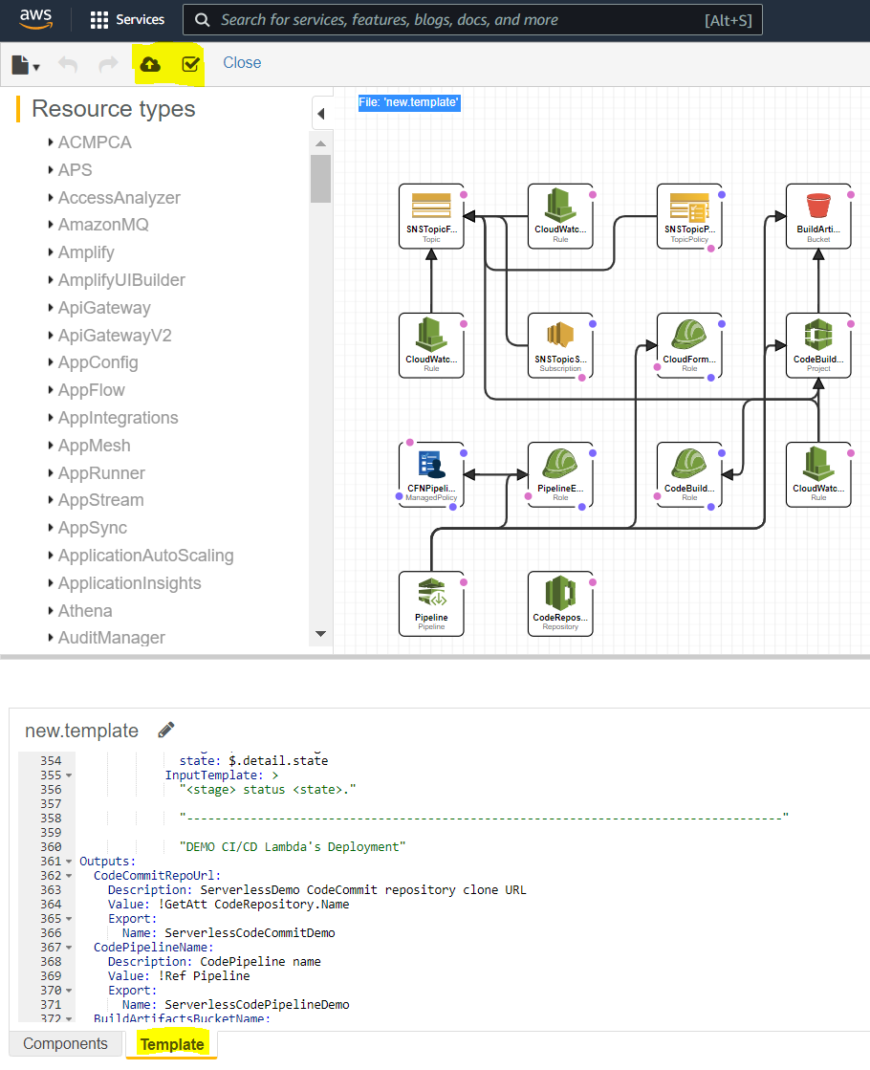
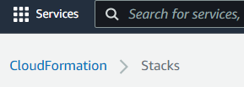
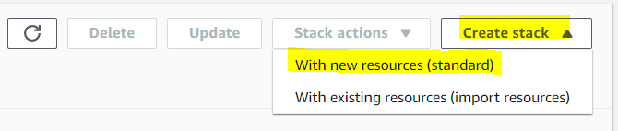
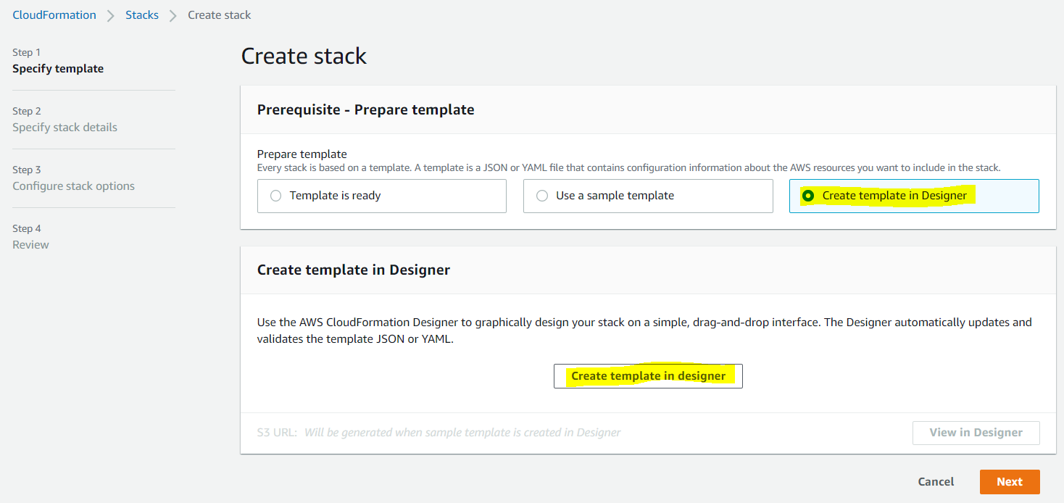
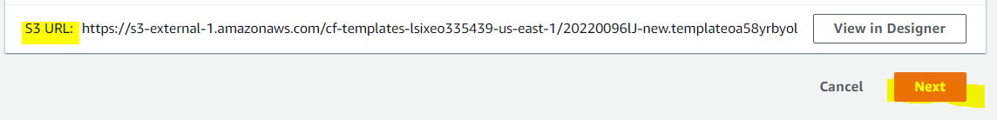
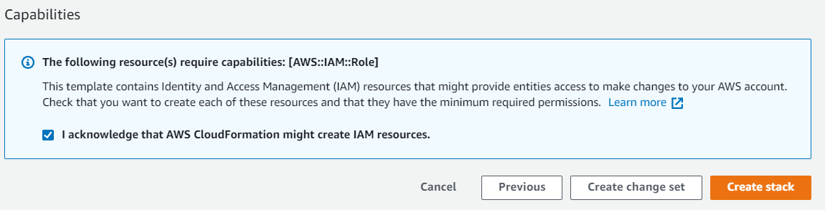
DevOps | IAC & Serverless CICD | Practical Hands-On
IAC – Cloudformation Stack Creation

Slide 18
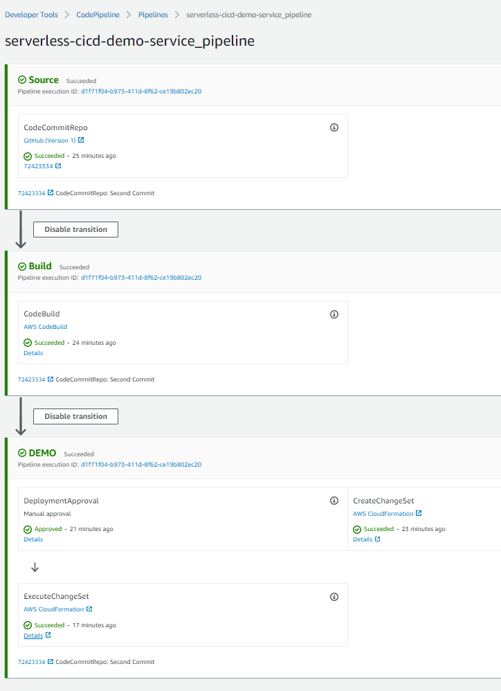
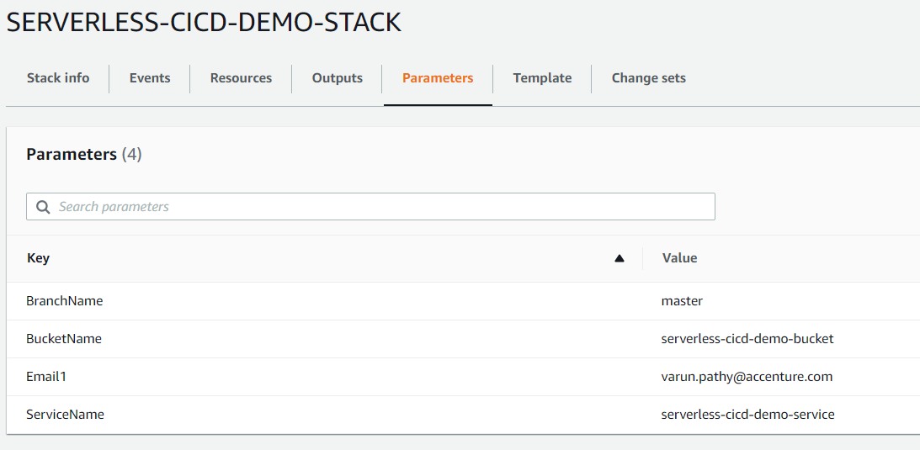




DevOps | IAC & Serverless CICD | Practical Hands-On
CI/CD CodePipeline View
Stack Name: SERVERLESS-CICD-DEMO-STACK
Stack Name: SERVERLESS-CICD-DEMO-LAMBDA-ROLE
Once the Demo has been succefully completed. Delete the Stacks as per below screenshot.
Delete Order:
serverless-cicd-demo-service-Stack-DEMO
SERVERLESS-CICD-DEMO-STACK
SERVERLESS-CICD-DEMO-LAMBDA-ROLE

Slide 19






DevOps | IAC & Serverless CICD | Practical Hands-On
GitFlow Process for working with CodeCommit or Github Repo

Slide 20









DevOps | IAC & Serverless CICD | Practical Hands-On
GitFlow Process for working with CodeCommit or Github Repo
NOTE
Prior to updating the code repo connection to Github , make sure to create a Github personnel access token & a repo to store sample code files.
You can do that by logging into your Github account & going to path as per screenshot below & create a Personnel Access token. Once you have the token created , copy & save with you.
Click on Connect to Github & mention the name of the REPO & Branch. Once the details have been added save changes to the CI/CD Pipeline.
CI/CD Pipeline then will pick up the code files from the repo & automatically trigger the Pipeline & Automate the Deployment.

Slide 21
That’s it folks!

